Slide 1
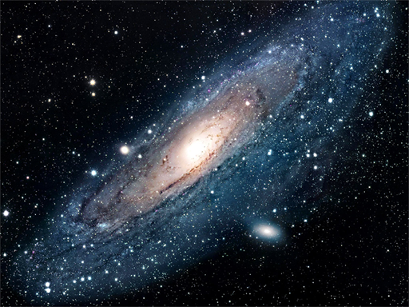


How Far
?
Is Far?

Slide 2
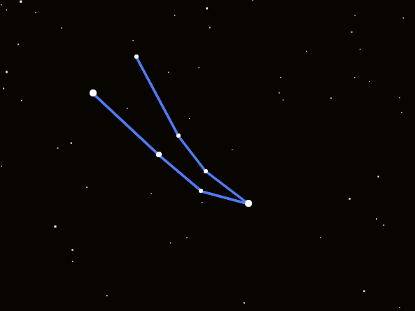
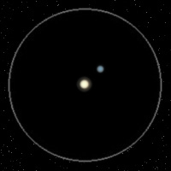
Gamma (γ) Andromeda
Through the Telescope
Andromeda
When seen through the telescope, Gamma Andromeda turns out to be two stars known as a contrast multiple star.

Slide 3
Gamma (γ) Andromeda
Contrast Multiple Star
Andromeda
A contrast multiple star is two (or more) stars, of different color and brightness that orbit each other.

Slide 4
Gamma (γ) Andromeda in the Night Sky
γ And
Andromeda
Gamma Andromeda is the 3rd brightest star in the constellation Andromeda, “The Chained Maiden”. It is found in the Eastern Fall sky soon after dark.

Slide 5
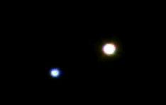
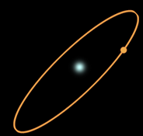
Star Pairs
Pairs of stars come in two varieties:
Optical Double Stars
Binary Stars

Slide 6

Optical Double Stars
Optical Double stars are just two stars that happen to lie in the same direction in the sky.
(A side view)
If you could see these stars from a different vantage point than Earth, you would see these stars actually have nothing to do with each other.

Slide 7

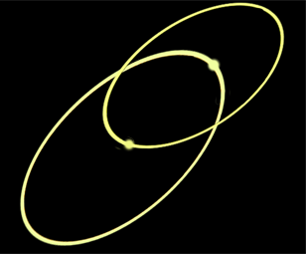
Binary Stars
In a Binary (or Multiple) star system the stars lie together in space and orbit each other.
Massive star with small companion
Two stars of similar mass

Slide 8

How do You Tell Which One
You Are Looking At ?
It's all in the distance.
Binary stars lie together in space, about the same distance from Earth.
Optical Double stars lie very far apart.

Slide 9
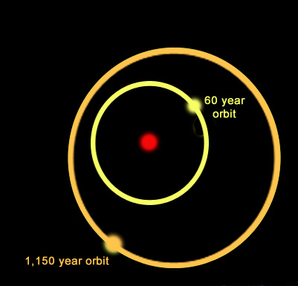
Multiple Star Systems
Multiple star systems come in many varieties. For example, the system shown here is a triple star system:
A yellow star orbits a primary star with a period of nearly 60 years while a more distant companion orbits the inner pair with a period of 1,150 years.
One multiple star system we know of has 9 stars!

Slide 10
Contrast Multiple Stars
A 'Contrast Multiple' is a multiple star system whose members have different colors and brightness.
A multiple star system with a blue star and a yellow star

Slide 11
Why Are Stars Different Colors?
Stars form with different amounts of hydrogen. High-mass stars have lots of hydrogen so they burn hotter and faster than stars with less fuel.
Thus high-mass stars have different temperatures, colors and life-spans than low-mass stars.

Slide 12
Contrast Multiple Stars
Blue stars are more massive and hotter than yellow or red stars. Stars of different masses evolve differently.

Slide 13
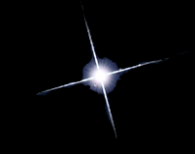

Types of Middle-Aged Stars
Blue stars are
high-mass hot stars.
Yellow stars are similar to our Sun. They are average in mass and temperature.
Red stars are
low mass and cool.

Slide 14
Contrast Multiple Stars
Can you identify:
Which star is brightest?
Which star is hottest?
Which star is largest?

Slide 15
Contrast Multiple Stars
In this case, the blue star is the hotter of the two, yet the yellow star is the brightest.

Slide 16
Contrast Multiple Stars
How can a star be brighter If it is cooler?

Slide 17
Contrast Multiple Stars
In this case the cooler, yellow star is brighter, so it must be larger.
The yellow star is starting to die, so it is turning into a giant.

Slide 18
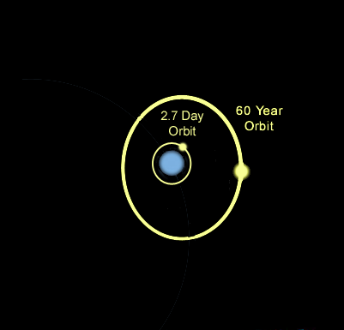
Gamma (γ) Andromeda (B)
γ And B
γ And A
The blue star in Gamma Andromeda (designated “B”) turns out to have two more stars orbiting it.

Slide 19
Gamma (γ) Andromeda (B)
The closest star is only one million miles away from γ Andromeda (B). That's so close that it's orbit is less than 3 days!
The second star lies about
three billion miles away and has a 60 year orbit. This makes γ Andromeda (B) a triple star system!

Slide 20
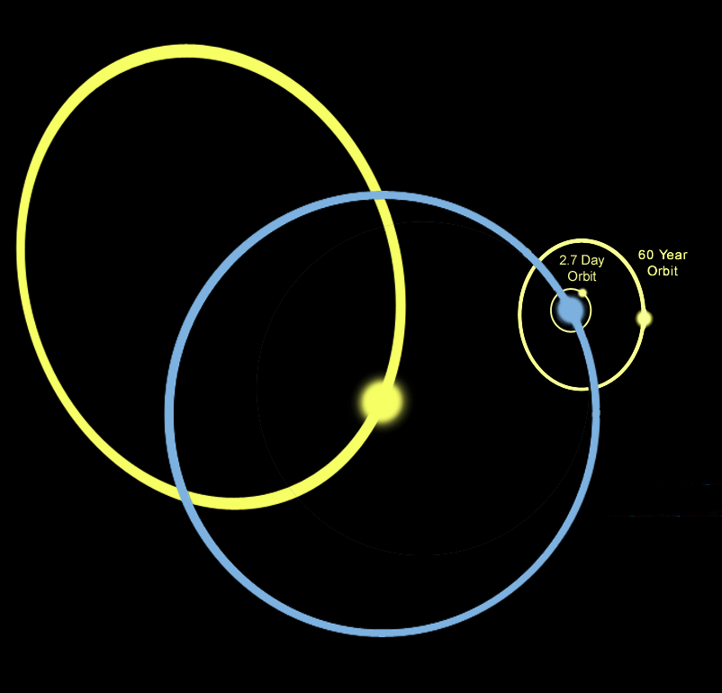
Gamma (γ) Andromeda System
This means that Gamma Andromeda has a total of 4 stars orbiting each other!

Slide 21
Gamma (γ) Andromeda
2,082,322,080,000,000 miles
Gamma Andromeda lies 355 light years away. That’s over 2,082 trillion miles away! So, how do astronomers “measure” these incredible distances?

Slide 22
How Far Away are the Stars?
Earth
Nearby star
ρ
Background stars
Sun
d
ρ
Apparent positions of the nearby star for observations taken 6 months apart.
Photographing a nearby star from different sides of our orbit around the Sun make it seem to shift in the sky. This shift, called parallax, can be used to find the distance to “nearby” stars.

Slide 23
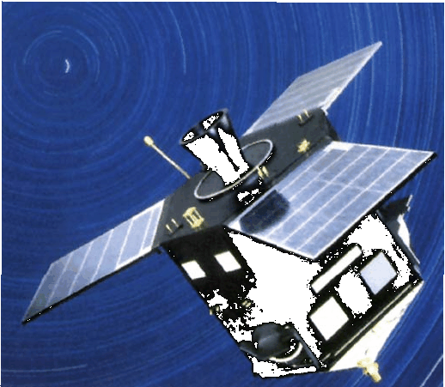
Hipparcos and Parallax
In August, 1989 the
Hipparcos satellite was
launched on its 3.5 year
mission. By March, 1993 it had plotted the positions of 120,000 stars with unprecedented precision.

Slide 24
Hipparcos and Parallax
Hipparcos achieved an angular resolution of 1.0 milliarcsecond. That is equivalent to measuring the angle between the two edges of a dime 2,500 miles away!

Slide 25
Hipparcos and Parallax
Hipparcos was able to push the limit of direct parallax measurements to “nearby” stars out to about 1,500 light years away.

